Slide 1
TELESCOPE CONTROL SOFTWARE
Version 04, 15/08/2017
Jean-Pierre Rivet
CNRS, OCA,
Dept. Lagrange
jean-pierre.rivet@oca.eu
© C2PU, Observatoire de la Cote d’Azur,
Université de Nice Sophia-Antipolis
Notes:
Conférence présentée à PARSEC, le 1er octobre 2005.

Slide 2
Launching the TCS
TCS: Telescope Control System (or Software)
On the Telescope control computer’s desktop,
double left-click on the TCS software icon:
Unless otherwise specified, always use the icon with
the highest version number (here: 76).

Slide 3
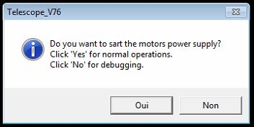
Launching the TCS
TCS: Telescope Control System (or Software)
A banner pops up, asking for permission
to switch the power boards on:
Answer “Yes” for a normal observation run,
or “No” for a debugging session.

Slide 4
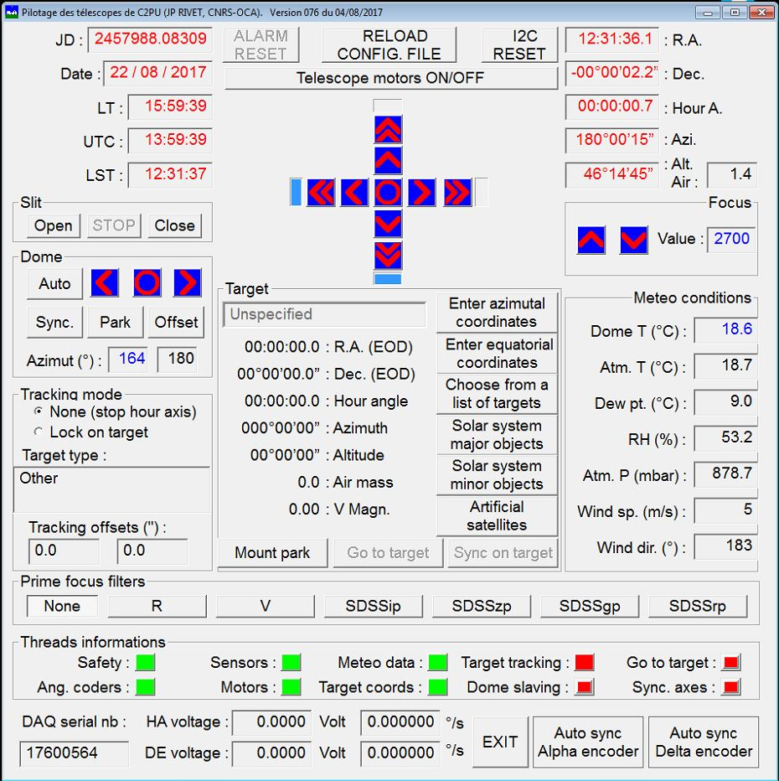
The TCS GUI
GUI: Graphic User Interface

Slide 5
The TCS GUI
GUI: Graphic User Interface
Hardware
control
Date / Time
Slit control
Telescope’s
coordinates
Dome control
Focalization
Tracking
modes
Telescope’s
keypad
Prime focus
filters
Meteo
conditions
Target infos
Threads infos
Service zone

Slide 6
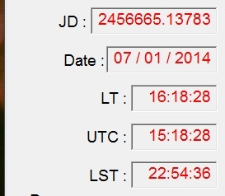
The date / time zone
UTC Julian date
Date (Local Time)
Time (Local Time)
UTC time
True Local Sidereal Time

Slide 7
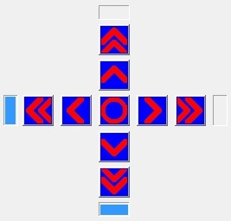
The keypad zone
Hour angle ↓ slow
Declination > 0
Hour angle ↓ fast
Declination ↑ fast
Hour angle < 0
Declination ↑ slow
Declination ↓ slow
Hour angle > 0
Declination ↓ fast
Hour angle ↑ fast
Declination < 0
Hour angle ↑ slow

Slide 8
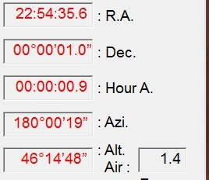
The telescope’s coordinates zone
Right ascension (hh:mm:ss.s)
Declination (+dd°mm’ss.s’’)
Hour angle (hh:mm:ss.s)
Airmass
Azimuth (ddd°mm’ss’’)
Elevation (dd°mm’ss’’)

Slide 9
The slit control zone
Stop any ongoing process
Start the dome’s
slit opening process
Start the dome’s
slit closing process

Slide 10
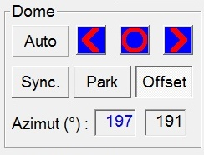
The dome control zone
Dome rotation
East
Start automatic
mode
Dome rotation
Stop
Set dome in
park position
Dome rotation
West
Synchronize
dome’s encoder
(requires privilege)
Validate azimuth
correction ^{(*)}
Dome’s
azimuth ^{(*)}
Corrected
target
azimuth ^{(*)}
(*) more on that later...

Slide 11
Azimuth correction
Auxiliary
instrument
Optical axes
offset
Main
instrument
Far from meridian, the dome azimuth
must be corrected for the optical axis offset

Slide 12
The focus zone
Focus ↑
Focus index
Focus ↓

Slide 13
The prime focus filter zone
The F/3.2 coma-corrected prime focus of the Omicron@C2PU telescope
has a built-in 6-slots computer-controlled filter loader:
No filter
Filter 1
Filter 2
Filter 3
Filter 4
Filter 5
Filter 6
NOTA: the 6 filters have to be chosen once for all at the beginning of the training period, among the following list of available filters:
SDSS (Sloan) g’, r’, i’ or z’
Astro-photographic (Baader) R, G, B, or Luminance
Hα (BW=5nm)
O-III (BW=8.5nm)

Slide 14
The tracking mode zone
Telescope
is halted
Telescope is
locked on its
target
Hour angle
offset (’’)
Tracking type
Declination
offset (’’)

Slide 15
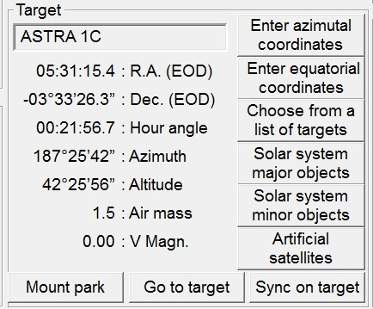
The target zone
Target’s apparent
EOD coordinates
Target’s defined by:
Azimutal cords.
Name
Equatorial cords.
or object name
Right Ascension
Declination
Select from a
scroll list
Hour angle
Azimuth
Solar System
planets
Elevation
Airmass
Asteroids,
comets
Visual magnitude
Set telescope
in park position
Slew to
target
Synchronize
encoders
Satellites

Slide 16
Enter azimuthal coordinates
Define the target by its azimuth and elevation
Enter azimuth
NOTA: input formats:
type 180 for 180° 00’ 00’’
type 145 12 for 145° 12’ 00’’
type 110 21 34 for 110° 21’ 34’
type 91.5 for 91° 30’ 00’’
Enter elevation
... then left-click on OK to validate, or on Cancel to dismiss

Slide 17
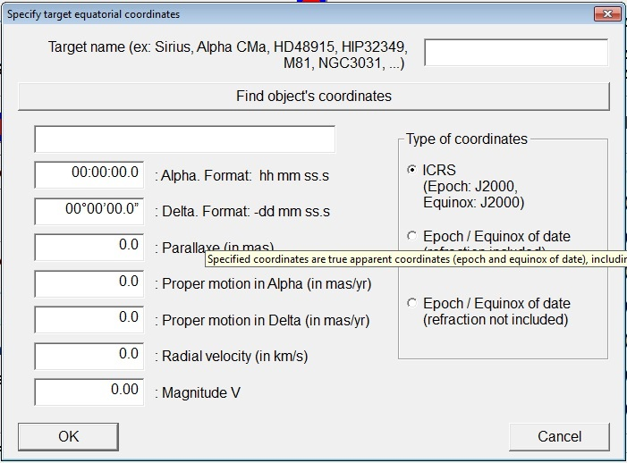
Enter equatorial coordinates
Method 1: Define the target by its name
Enter target’s identifier
(ex: M31, Aldebaran,
HD209458, NGC7635,
4UCAC556-032452 ...)
Then left-click on the button
“Find objects coordinates”
The software launches
automatically a request to
a WEB stellar database
(SIMBAD database at CDS).

Slide 18
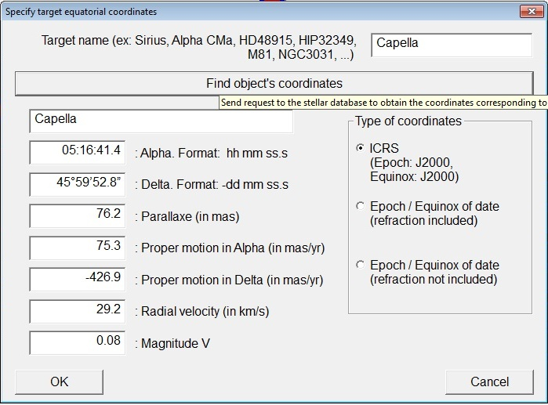
Enter equatorial coordinates
Method 1: Define the target by its name
The target’s name and
equatorial coordinates
should appear within seconds.
... then left-click on OK to validate, or on Cancel to dismiss

Slide 19
Enter equatorial coordinates
Method 1: Define the target by its name
Should an error message pop up, then:
check internet connectivity
check spelling and syntax of the object’s identifier
(connect to http://simbad.u-strasbg.fr/simbad/sim-fid
and try to enter the identifier)
contact a local staff member and try Method 2.

Slide 20
Enter equatorial coordinates
Method 2: Define the target by its equatorial coordinates
Select the type
of coordinates
Enter target’s name
Enter target’s
equatorial coordinates
... then left click on OK to validate, or on Cancel to dismiss

Slide 21
Enter equatorial coordinates
Method 2: Define the target by its equatorial coordinates
PERMITTED FORMATS:
for right ascension (default unit: hours)
12 32 23 for 12h 32m 23s
12 32 for 12h 32m 00s
12 for 12h 00m 00s
14.50 for 14h 30m 00s
30.5 d for 30.5 degrees (02h 30m 00s)
for declination (default units: degrees)
20 54 36 for +20° 54’ 36’’
+20 54 36 for +20° 54’ 36’’
20 54 for +20° 54’ 00’’
20 for +20° 00’ 00’’
20.5 for +20° 30’ 00’’
20.5d for +20° 30’ 00’’

Slide 22
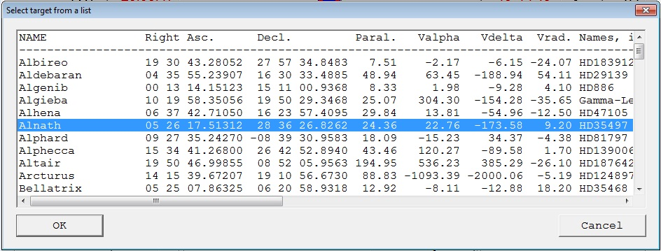
Choose from a list of targets
Displays a list of “popular” targets
Left-click on the desired line
... then left-click on OK to validate, or on Cancel to dismiss

Slide 23
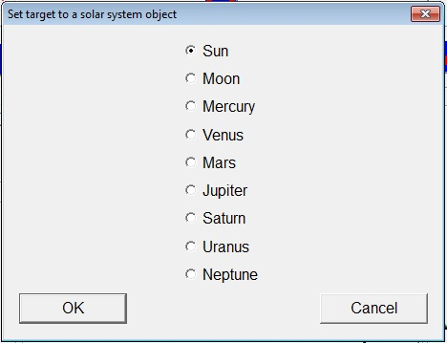
Solar System major objects
Displays a list of Solar System planets
Left-click on the desired object
... then left-click on OK to validate, or on Cancel to dismiss

Slide 24
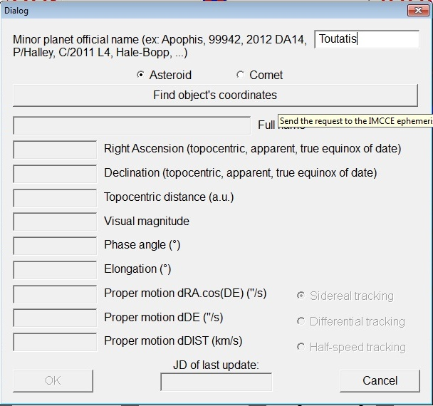
Solar System minor objects
Define the target (asteroid, comet) by its identifier
Enter object’s name
(ex: Toutatis, 868, 2012DA14...)
Select the type of object
Then left-click on the button
“Find objects coordinates”
The software launches
a request to a WEB ephemeris
server (IMCCE).
... then left-click on OK to validate, or on Cancel to dismiss

Slide 25
Solar System minor objects
Define the target (asteroid, comet) by its identifier
Should an error message pop up, then:
check internet connectivity
check spelling and syntax of the object’s identifier
contact a local staff member.

Slide 26
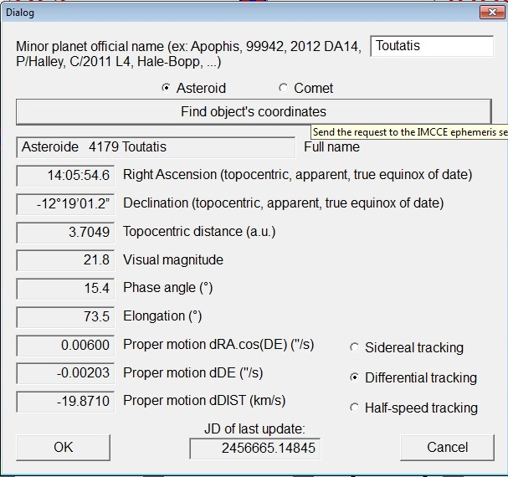
Solar System minor objects
Define the target (asteroid, comet) by its identifier
The target’s name and
equatorial coordinates
should appear within seconds.
Select the type of tracking:
Sidereal: telescope locks on the
initial position of the (moving) object
Differential: telescope locks on the
object itself (proper motion taken
into account)
Half-speed: telescope follows the
object, but with half is proper motion speed.
... then left-click on OK to validate, or on Cancel to dismiss

Slide 27
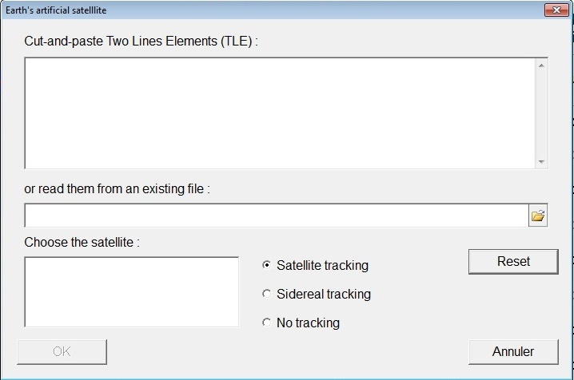
Earth’s artificial satellites
Editor for
NORAD’s TLE
(Two Lines Elements)
Satellite selector
TLE file browser
Tracking mode
selector
Clear all
Validate the choices
Exit without validation

Slide 28
Option 1: cut-and-paste TLEs
Cut-and-paste
TLEs here

Slide 29
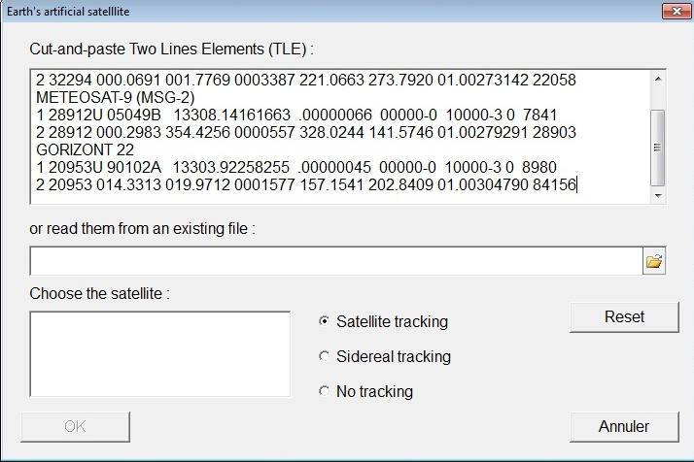
Option 1: cut-and-paste TLEs
Left-click here
to update the
satellite list

Slide 30
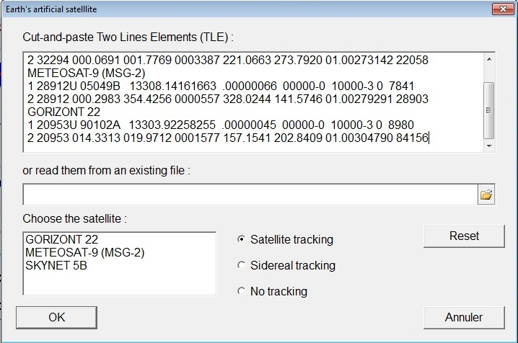
Option 1: cut-and-paste TLEs
Left-click on the
wanted satellite
to select it

Slide 31
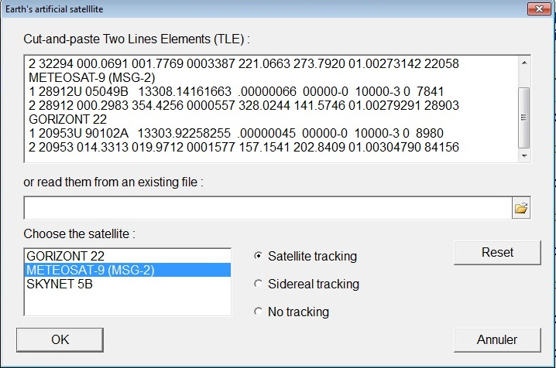
Option 1: cut-and-paste TLEs
Choose the
tracking mode ...
... then left-click
here to validate,
... or here
to dismiss.

Slide 32
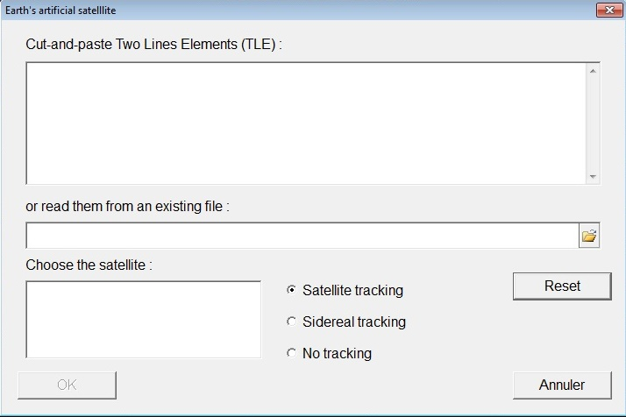
Option 2: get TLEs from a file
Left-click here to
open the file browser

Slide 33
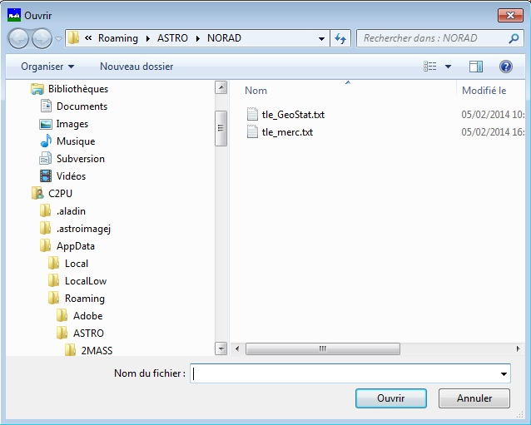
Option 2: get TLEs from a file
Navigate and select
the wanted TLE file

Slide 34
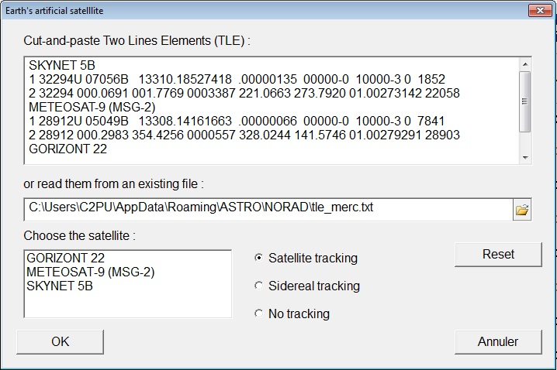
Option 2: get TLEs from a file
Select the
satellite ...
Choose the
tracking mode ...
... then left-click
here to validate,
... or here
to dismiss.

Slide 35
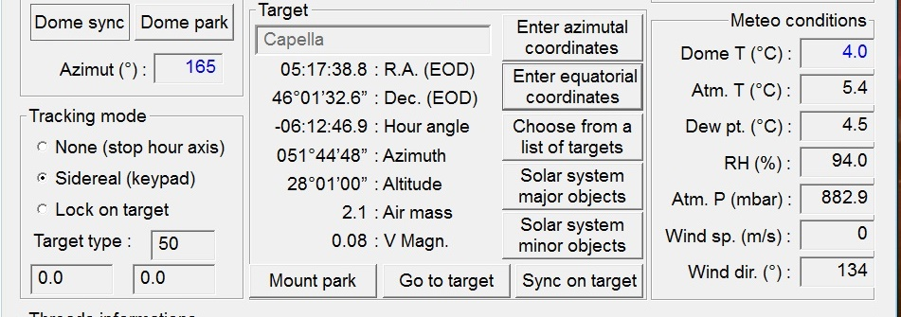
Check target’s observability
The target’s name and
apparent, refracted EOD
equatorial coordinates
are displayed in the
target zone
CHECK that the target is
in the observable zone !

Slide 36
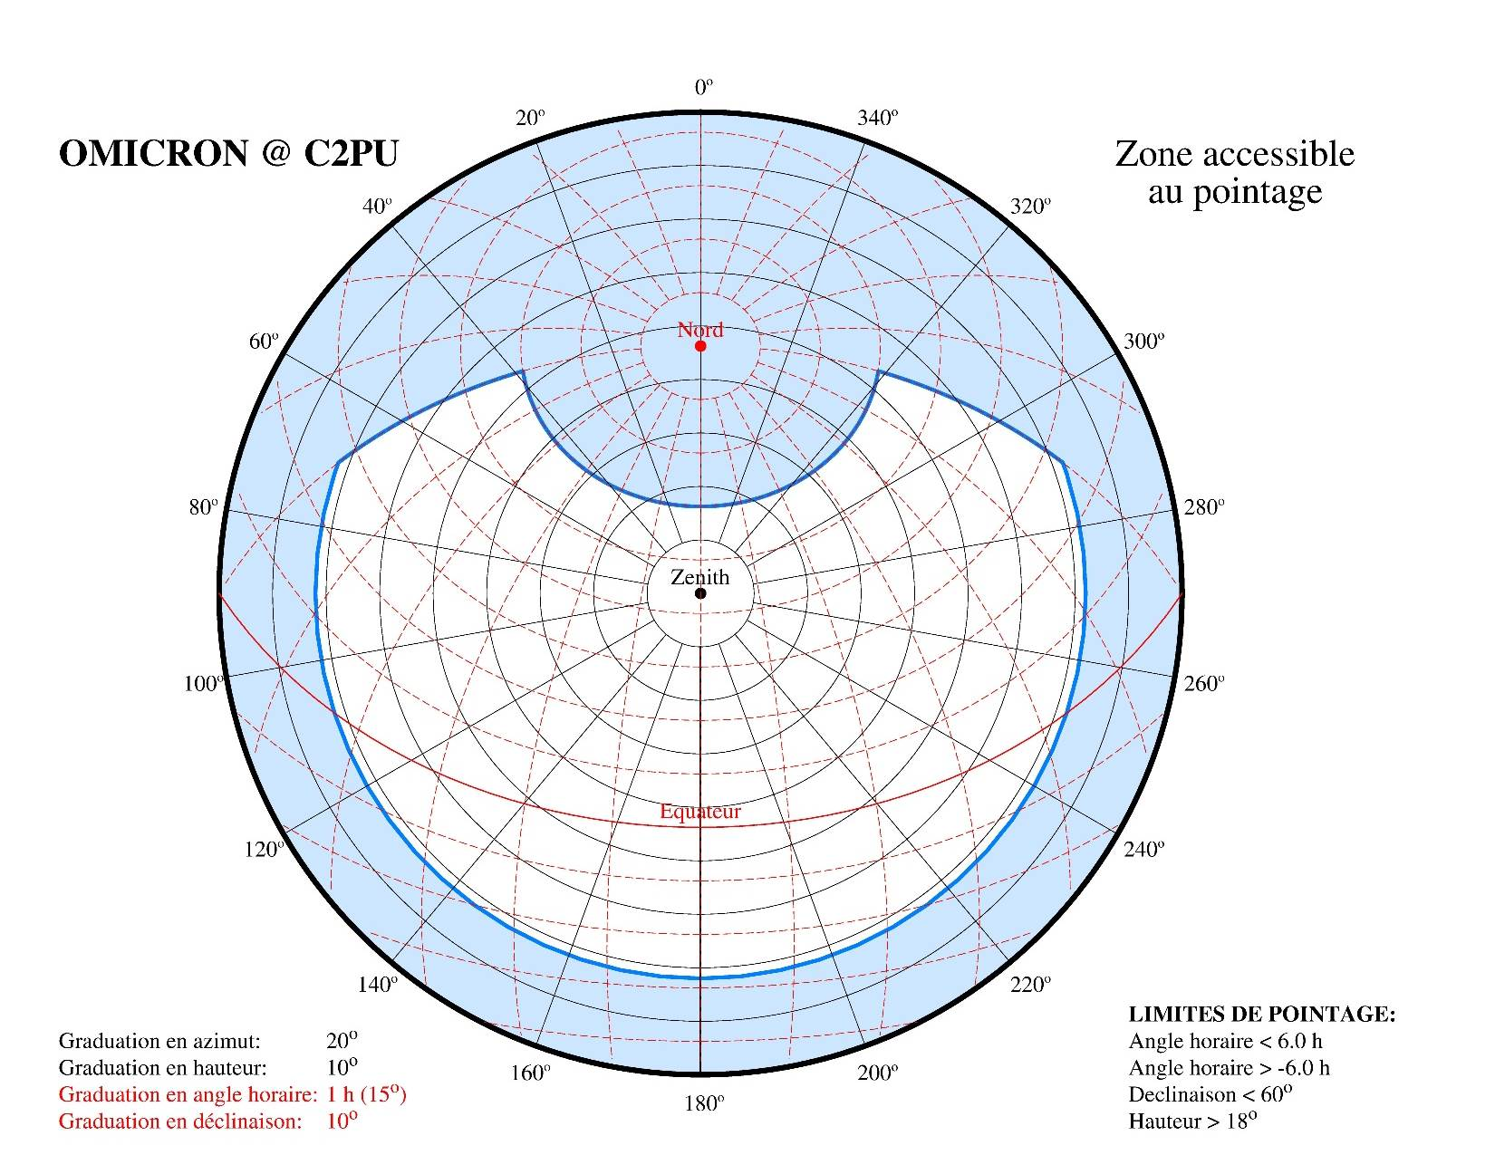
Observable zone
Elevation:
h > 18°
Declination:
< 60°
Hour angle:
-6^{h} < H < +6^{h}

Slide 37
Go to target !
Left-click on the
“Go to target”
button
A confirmation banner pops up ...
... then left-click on OK to validate, or on Cancel to dismiss

Slide 38
Interrupt the telescope’s slew
The “Go to target” thread
indicator turns green
If you need to interrupt
the telescope’s slew process,
left-click on the
“Go to target” thread indicator, which
should turn red within seconds:

Slide 39
Start the automatic dome control
TO BE DONE ONLY IF AN AUXILLIARY
OFF-AXIS OPTICAL INSTRUMENT IS USED !!!!
Left-click here to
validate the
azimuth correction
for shifted optics
The corrected
azimuth
appears here
The azimuth correction requires some geometrical
parameters (auxiliary instrument optical axis offset).
They should be entered in a configuration file
by an authorized staff member only.

Slide 40
Start the automatic dome control
Left-click on the
“Auto” button
The dome’s slit should slew automatically and stop
in front of the instrument’s aperture.
The dome’s position is corrected automatically
when needed.

Slide 41
Manual dome control
NEVER use
this button !
(authorized staff only)
If needed,
left-click on the
“Auto” button
to come back
to manual mode
Left-click on these
buttons to
move the dome

Slide 42
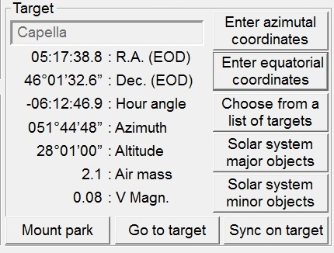
To end the observations
STEP 1: park the mount
Left-click on the
“Mount park” button
A confirmation banner pops up ...
... then left-click on OK to validate, or on Cancel to dismiss

Slide 43
To end the observations
STEP 2: park the dome
If needed,
left-click on the
“Auto” button
to come back
to manual mode ...
... then
left-click on the
“Park” button

Slide 44
To end the observations
STEP 3: close the dome
Left-click on the
“Close” button...
... then wait until the
“STOP” button becomes
disabled (grayed)

Slide 45
To end the observations
STEP 4: shutdown the TCS software
Left-click on the
“EXIT” button
The TCS shutdown process last some 20 seconds.
When the GUI disappears, the shutdown process is completed.

Slide 46
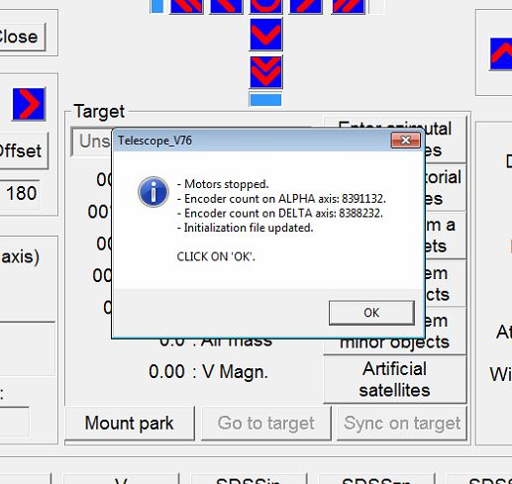
To end the observations
If a confirmation pop-up window appears:
... left-click on “OK”

Slide 47
END

Slide 48
END

